Slide 1
Geometric Transformations (2)
Computer Graphics

Slide 2
Reading
Hearn & Baker, Chapter 5
Angel, Chapter 4
Watt, Chapter 1

Slide 3
Contents
Geometric transformations in 3D space
Basic 3D geometric transformations
translation, rotation, and scaling
Composite 3D transformations
Other 3D transformations
reflection and shear
Transformations between 3D coordinate systems
Affine transformations

Slide 4
Geometric Transformations in 3D Space
Extended from 2D methods by including considerations for the z coordinate
Translation
3D translation vector
Scaling
three coordinate scaling factor
Rotation (less straightforward)
selection of any spatial orientation for the rotation axis
composite of three rotations, one for each of the three Cartesian axes
Homogeneous coordinates
four-element column vector
Transformation matrix
4x4 matrix

Slide 5
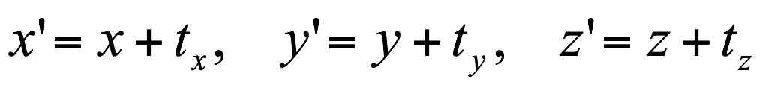
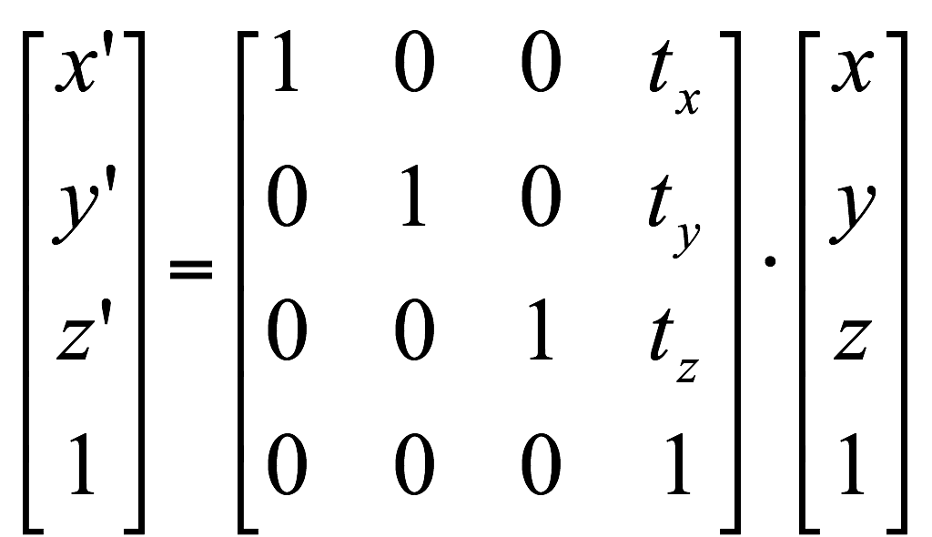

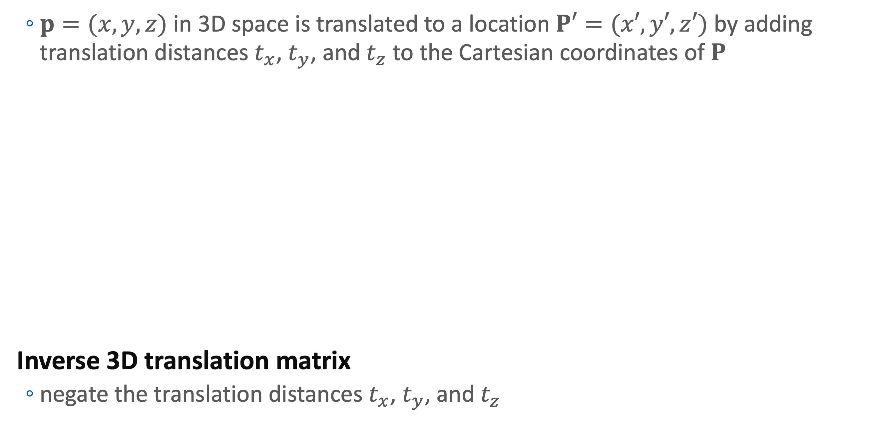
3D Translation
$p=(x, y, z)$ in 3D space is translated to a location $P′=(x′, y′, z′)$ by adding translation distances $t_{x}$, $t_{y}$, and $t_{z}$ to the Cartesian coordinates of $P$
Inverse 3D translation matrix
negate the translation distances $t_{x}$, $t_{y}$, and $t_{z}$
y axis
(x′, y′, z′)
(x, y, z)
T = (tx, ty, tz)
z axis
x axis

Slide 6
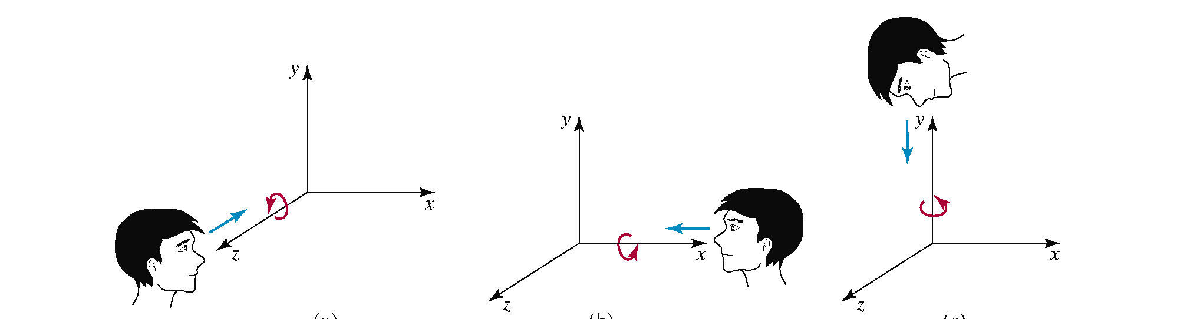
3D Rotation
We can rotate an object any axis in space
Cartesian coordinate axes
the easiest rotation axes
we can use combination of coordinate-axes rotations
assuming that we are looking in the negative direction along that coordinate axis

Slide 7
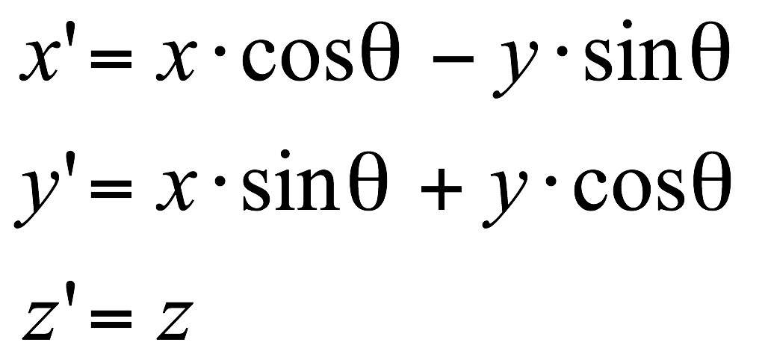
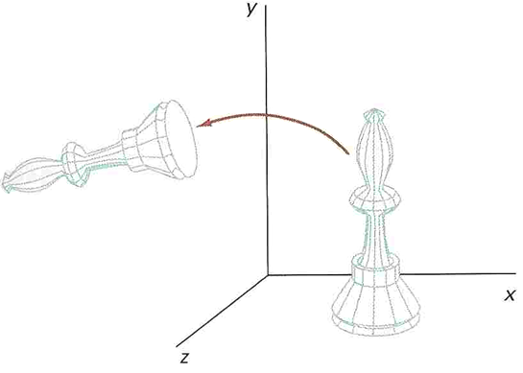
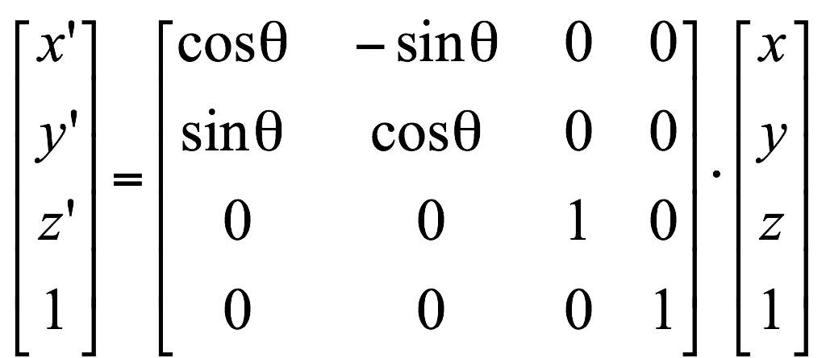
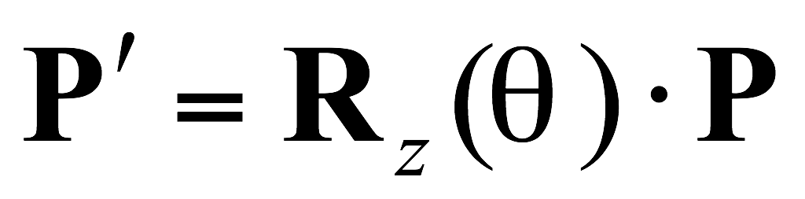
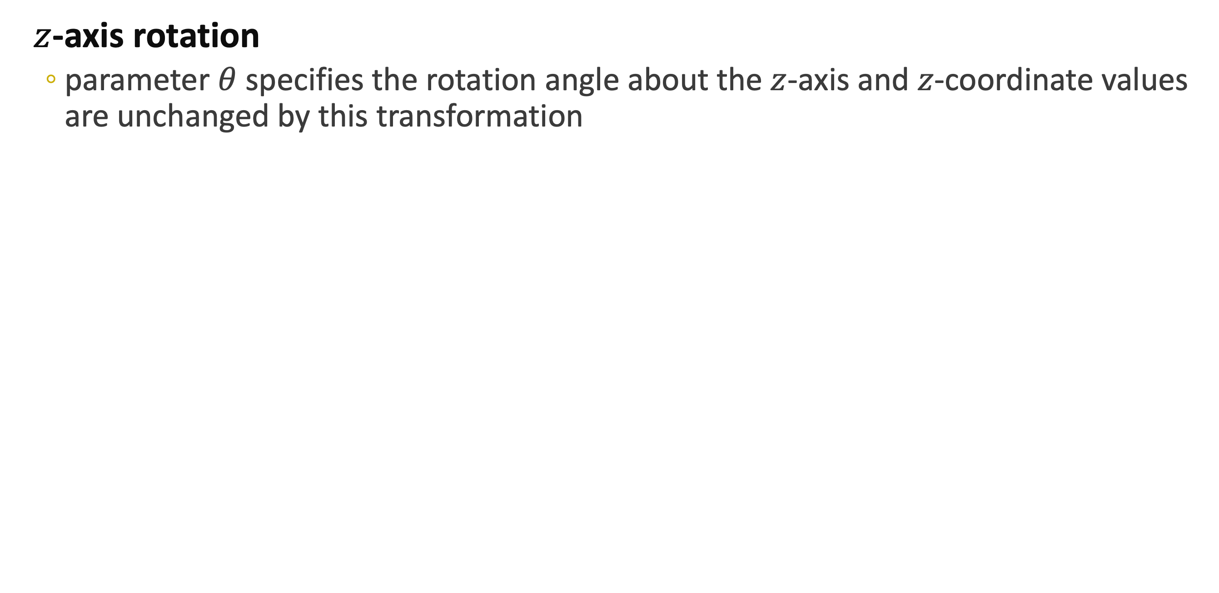
3D Coordinate-Axis Rotations
$z$-axis rotation
parameter $θ$ specifies the rotation angle about the $z$-axis and $z$-coordinate values are unchanged by this transformation

Slide 8
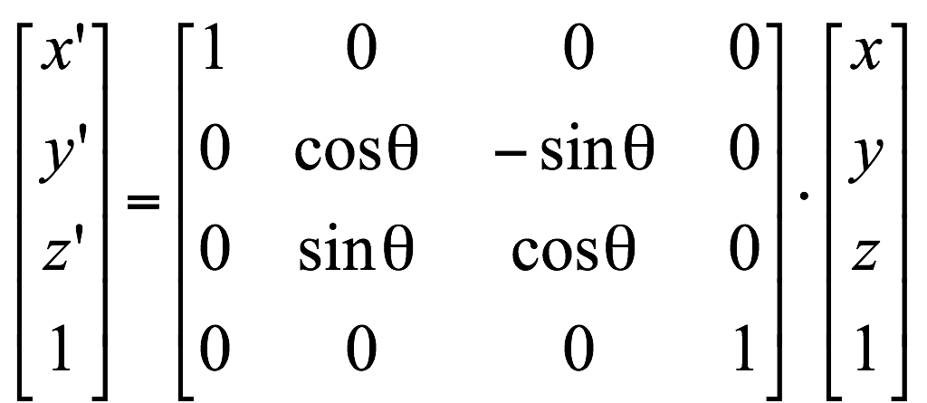
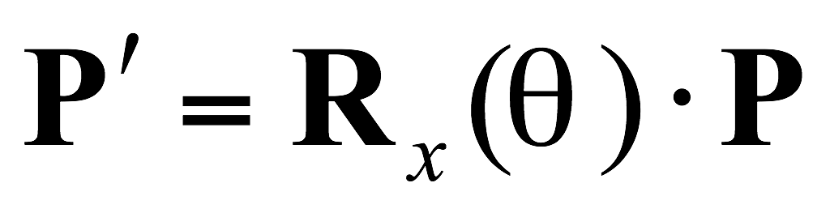
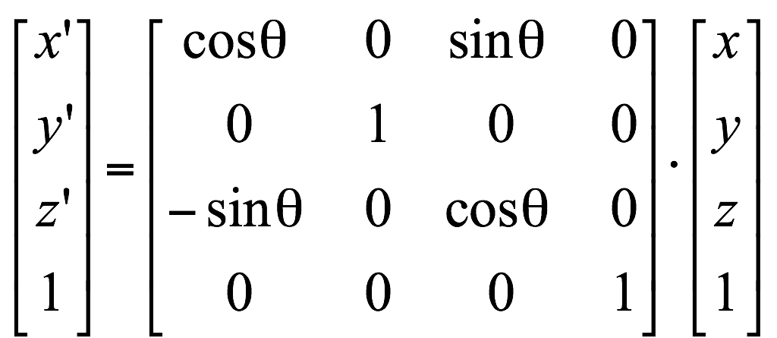
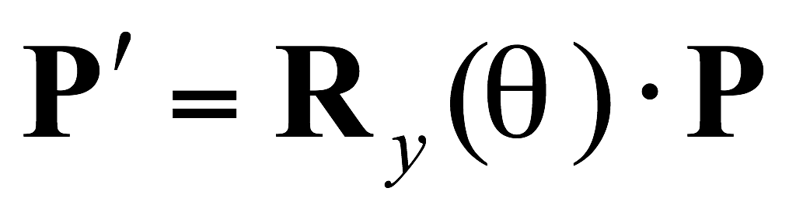
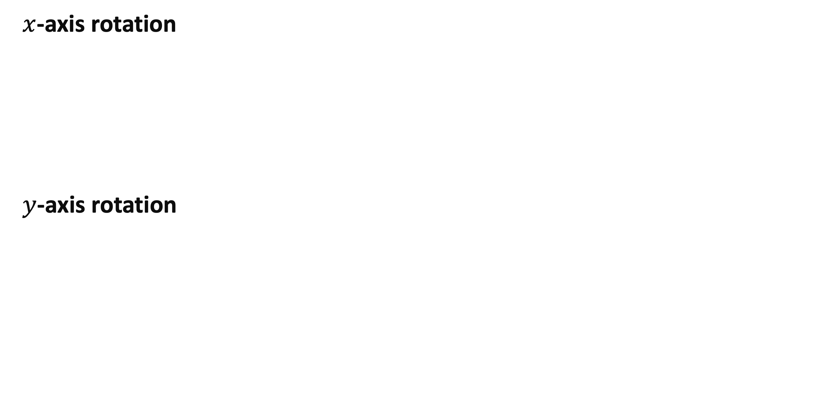
3D Coordinate-Axis Rotations
$x$-axis rotation
$y$-axis rotation

Slide 9
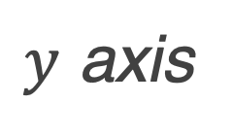
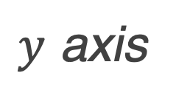
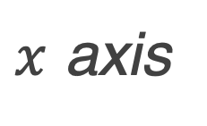
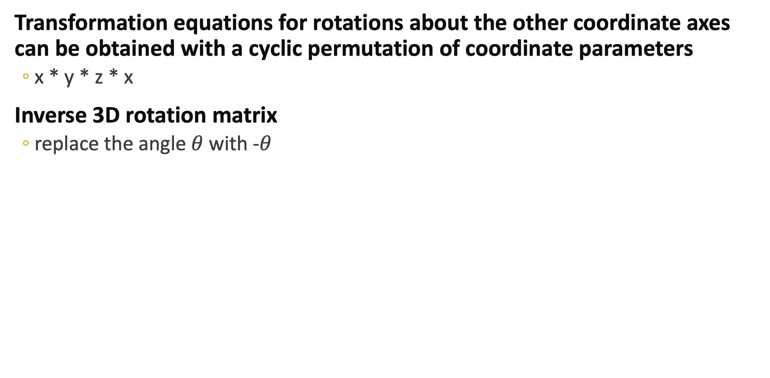
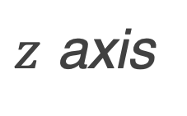



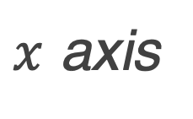
3D Coordinate-Axis Rotations
Transformation equations for rotations about the other coordinate axes can be obtained with a cyclic permutation of coordinate parameters
x * y * z * x
Inverse 3D rotation matrix
replace the angle $θ$ with -$θ$
$y$ axis
$z$ axis
$x$ axis
$z$ axis
$x$ axis
$x$ axis
$y$ axis
$z$ axis
$y$ axis

Slide 10
General 3D Rotation
Rotation for any axis
composite transformation involving combinations of translations and the coordinate-axis rotations
Move the designated rotation axis onto one of the coordinate axes
Apply the appropriate rotation matrix for that coordinate axis
Return the rotation axis to its original position

Slide 11
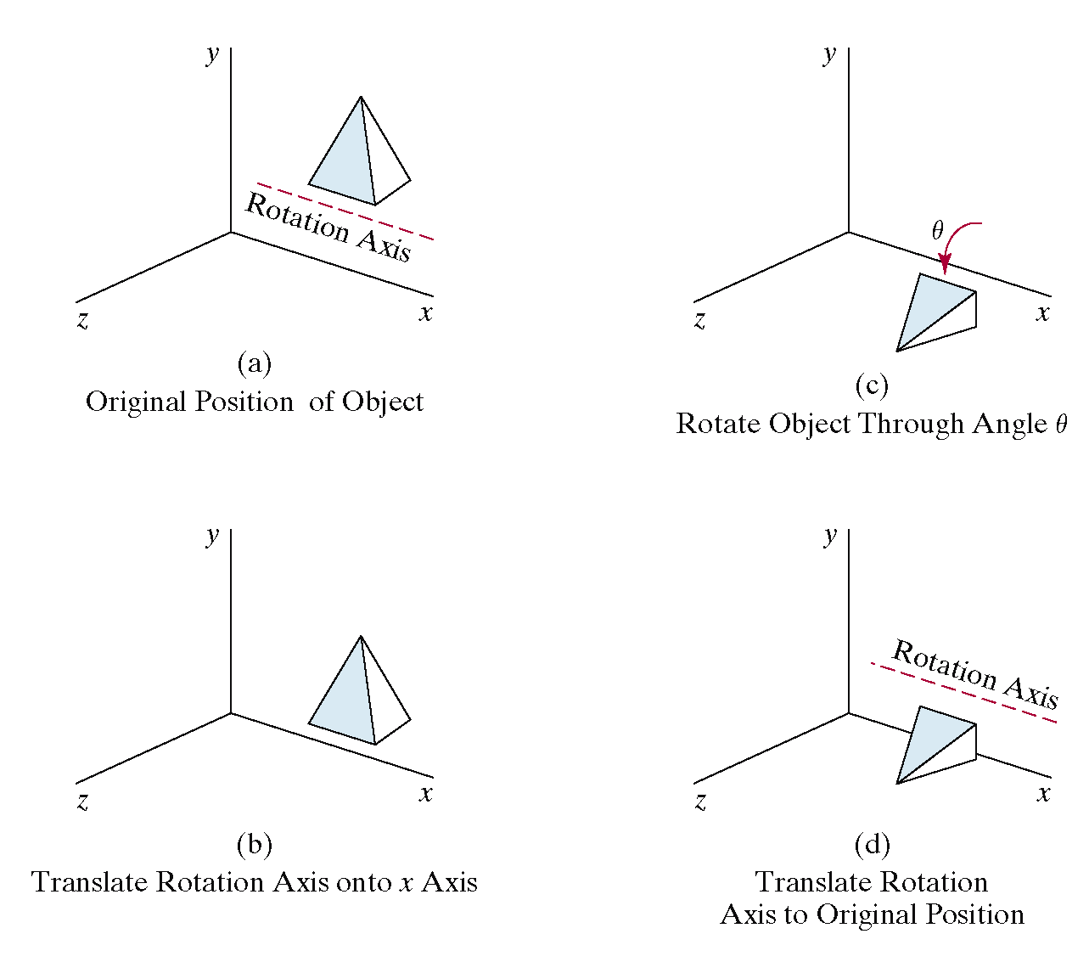
General 3D Rotation
Special case
rotation about an axis that is parallel to one of the coordinate axes
Translate the object so that the rotation axis coincides with the parallel coordinate axis
Perform the specified rotation about that axis
Translate the object so that the rotation axis is moved back to its original position

Slide 12
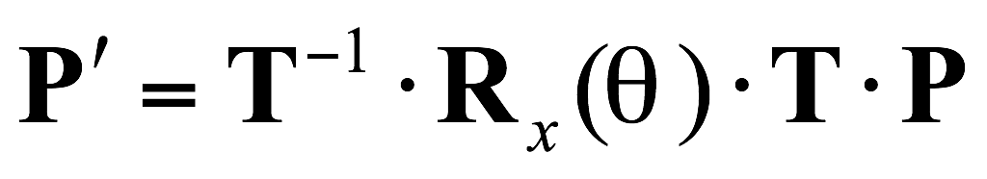

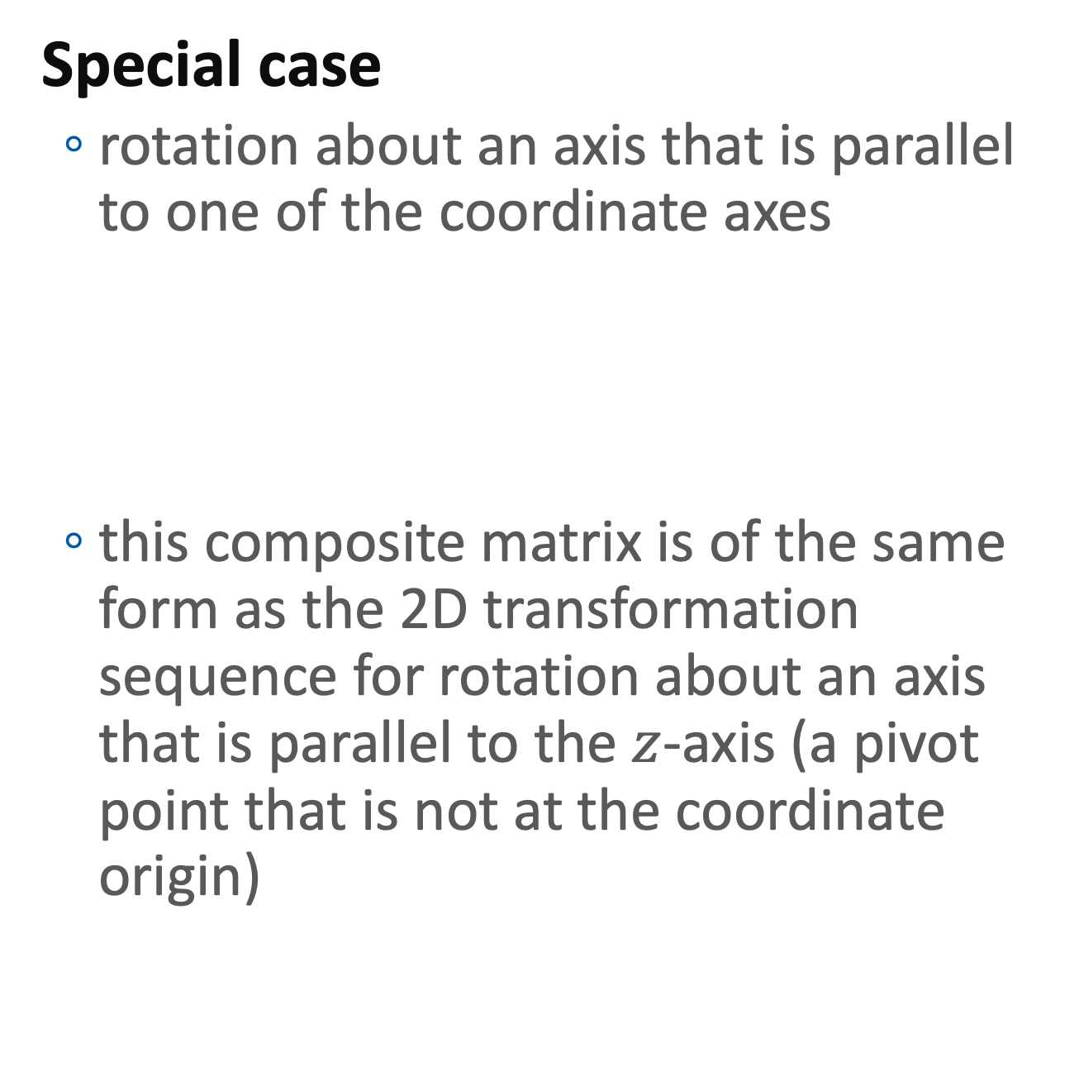
General 3D Rotation
Special case
rotation about an axis that is parallel to one of the coordinate axes
this composite matrix is of the same form as the 2D transformation sequence for rotation about an axis that is parallel to the $z$-axis (a pivot point that is not at the coordinate origin)

Slide 13
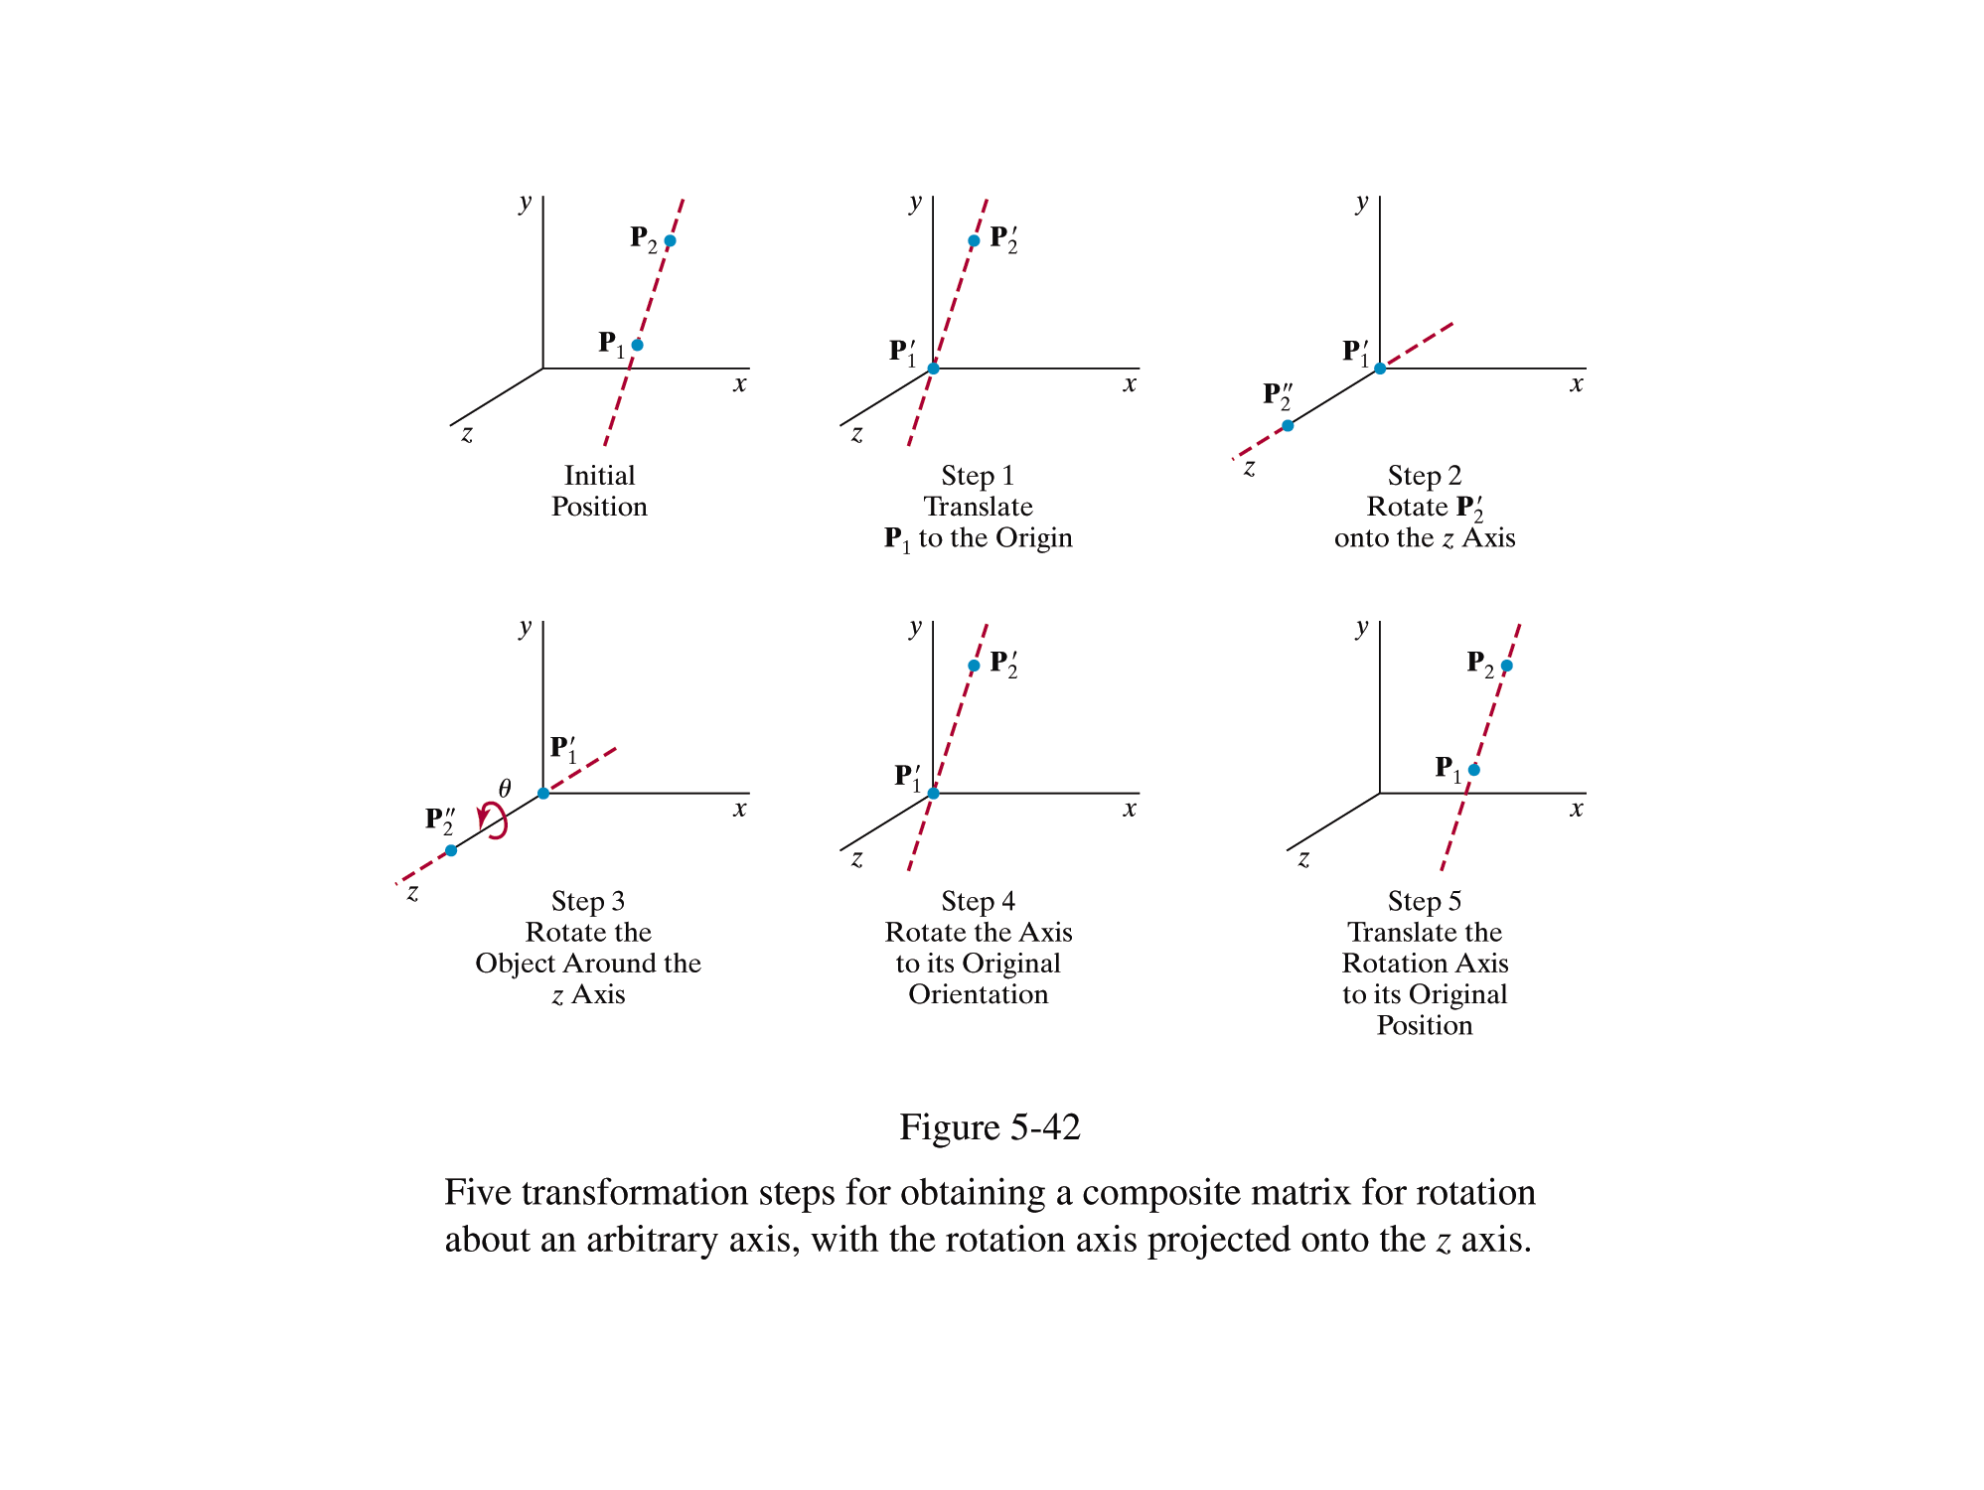
General 3D Rotation
Not parallel to one of the coordinate axes
need to perform some additional transformations

Slide 14
General 3D Rotation
Not parallel to one of the coordinate axes
need to perform some additional transformations
Translate the object so that the rotation axis passes through the coordinate origin
Rotate the object so that the axis of rotation coincides with one of the coordinate axes
Perform the specified rotation about that coordinate axis
Apply the inverse rotations to bring the rotation axis back to its original orientation
Apply the inverse translation to bring the rotation axis back to its original position

Slide 15
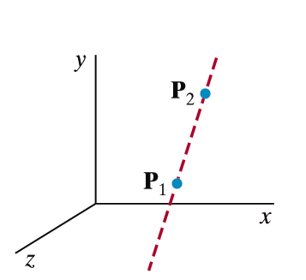
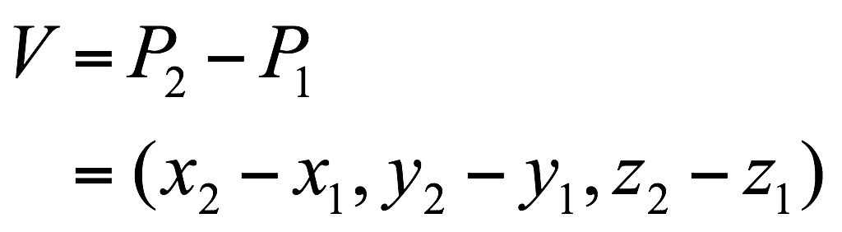
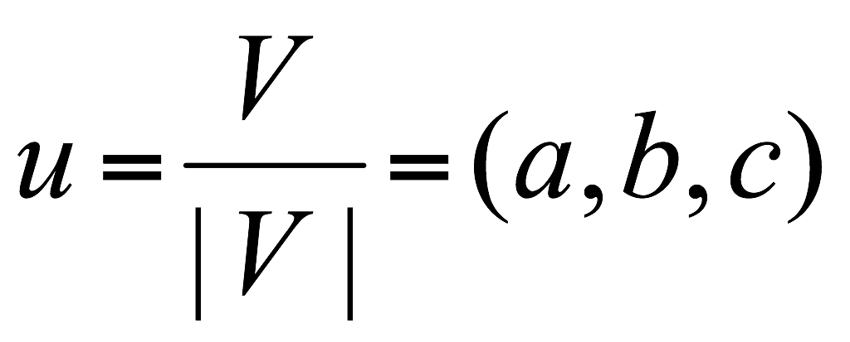
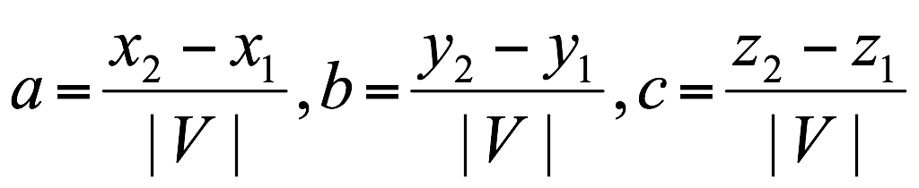
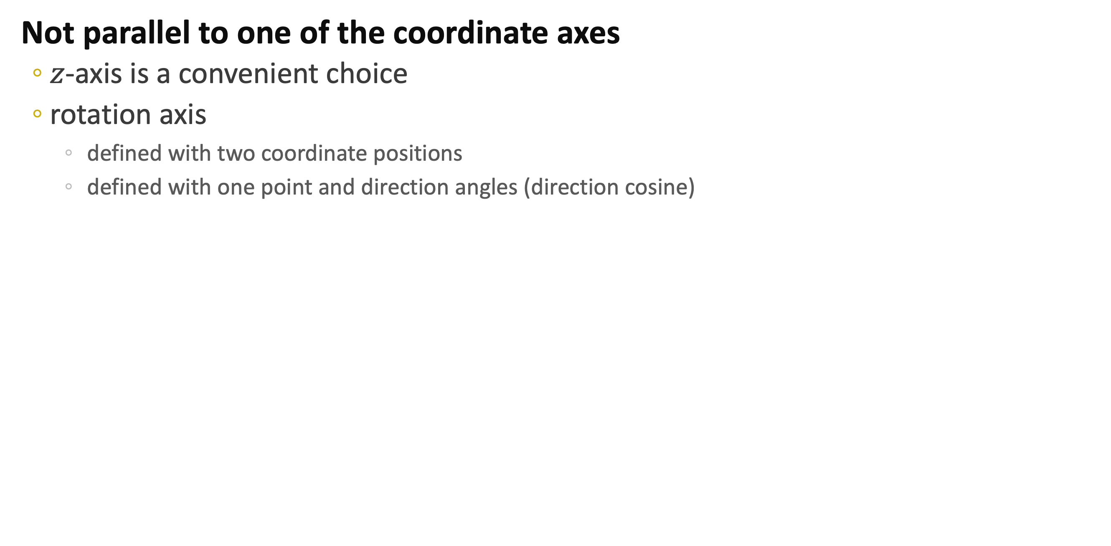
General 3D Rotation
Not parallel to one of the coordinate axes
$z$-axis is a convenient choice
rotation axis
defined with two coordinate positions
defined with one point and direction angles (direction cosine)
u

Slide 16
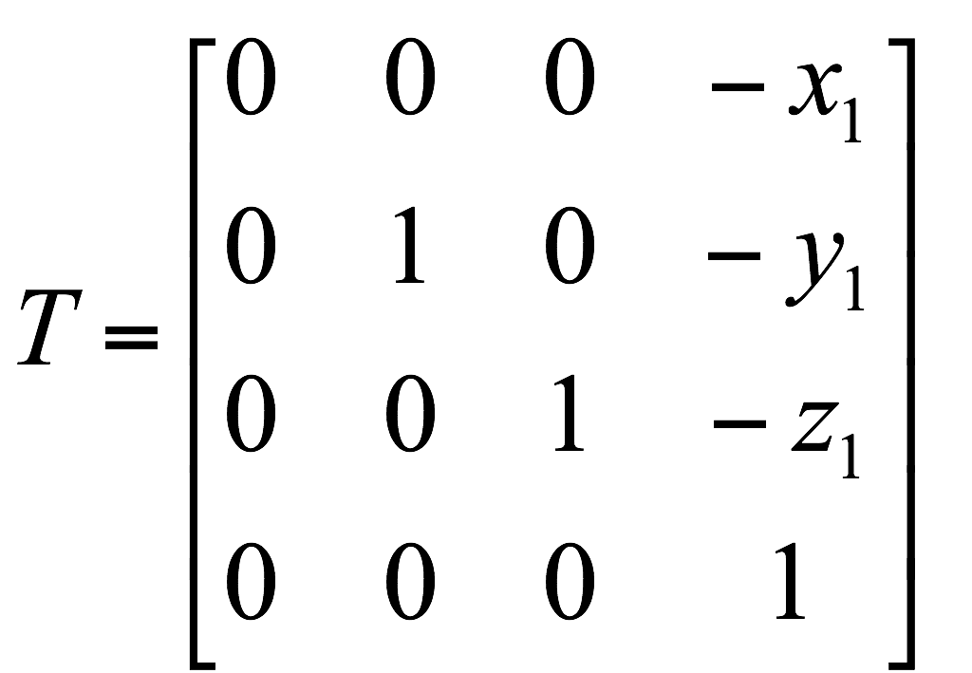
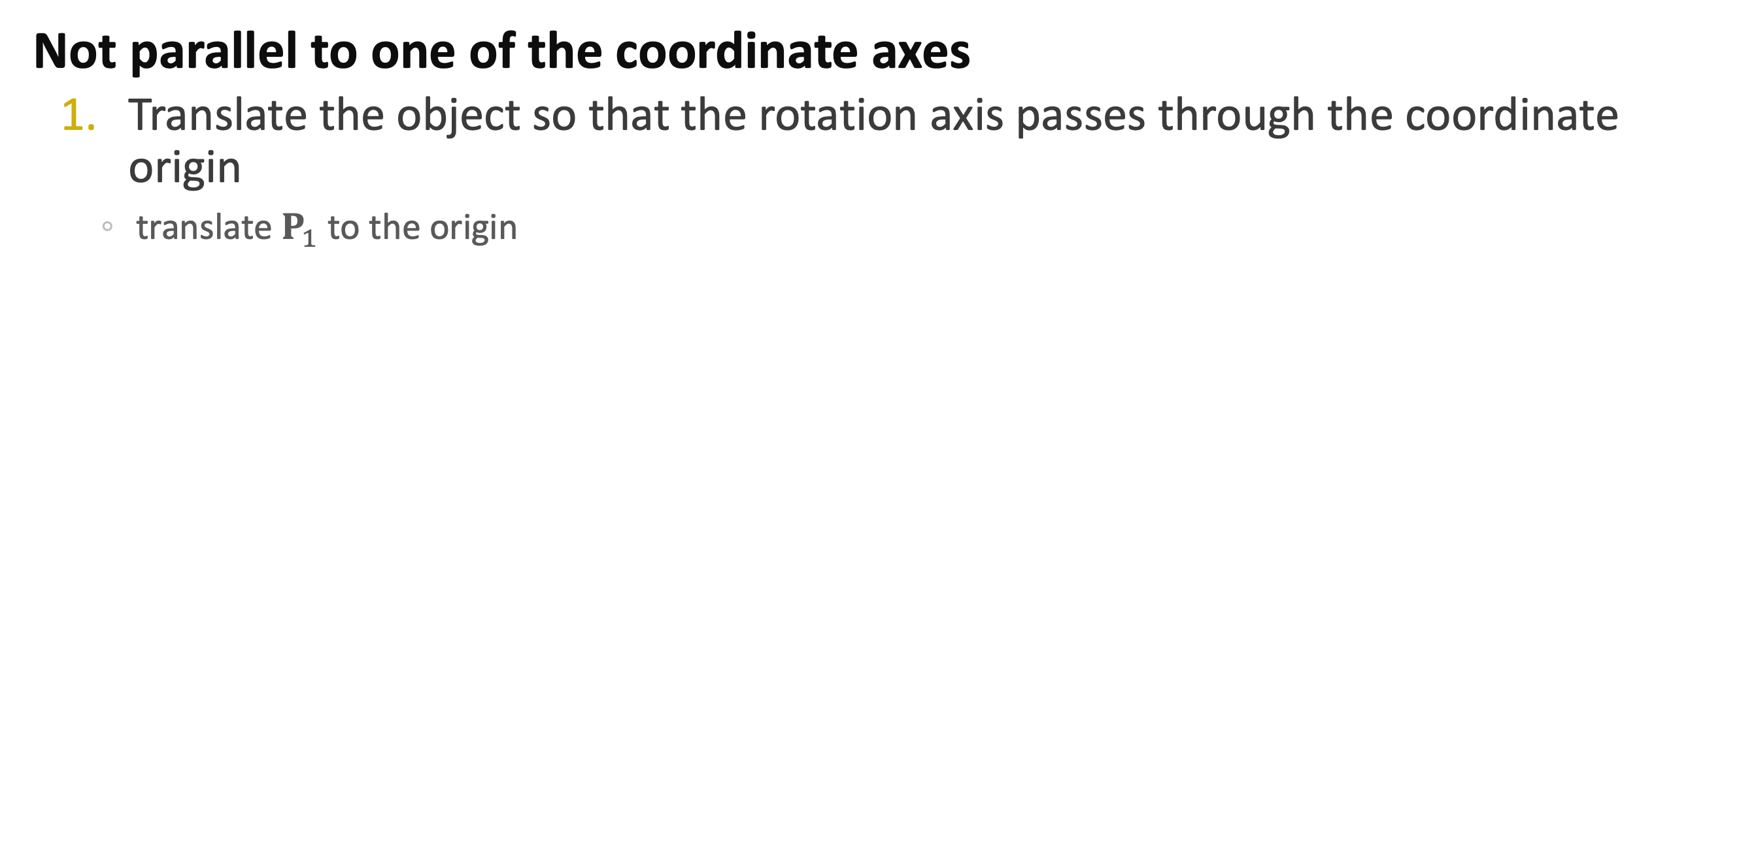
General 3D Rotation
Not parallel to one of the coordinate axes
Translate the object so that the rotation axis passes through the coordinate origin
translate $P_{1}$ to the origin
u
u

Slide 17
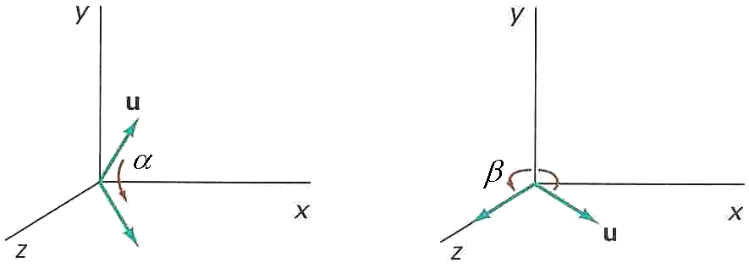
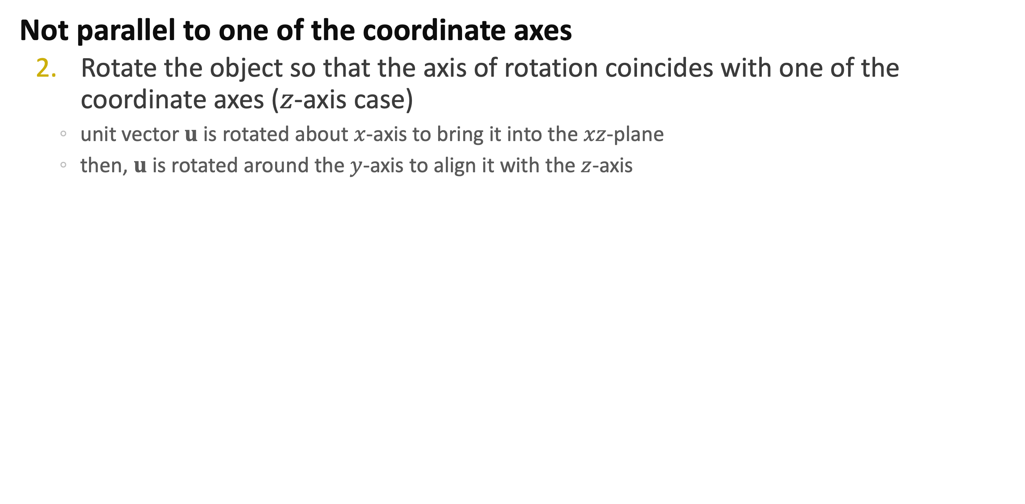
General 3D Rotation
Not parallel to one of the coordinate axes
Rotate the object so that the axis of rotation coincides with one of the coordinate axes ($z$-axis case)
unit vector $u$ is rotated about $x$-axis to bring it into the $xz$-plane
then, $u$ is rotated around the $y$-axis to align it with the $z$-axis

Slide 18
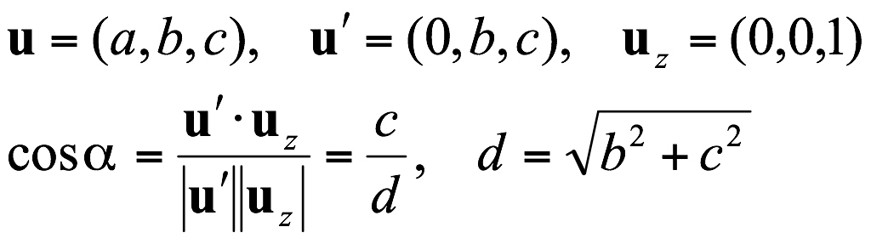
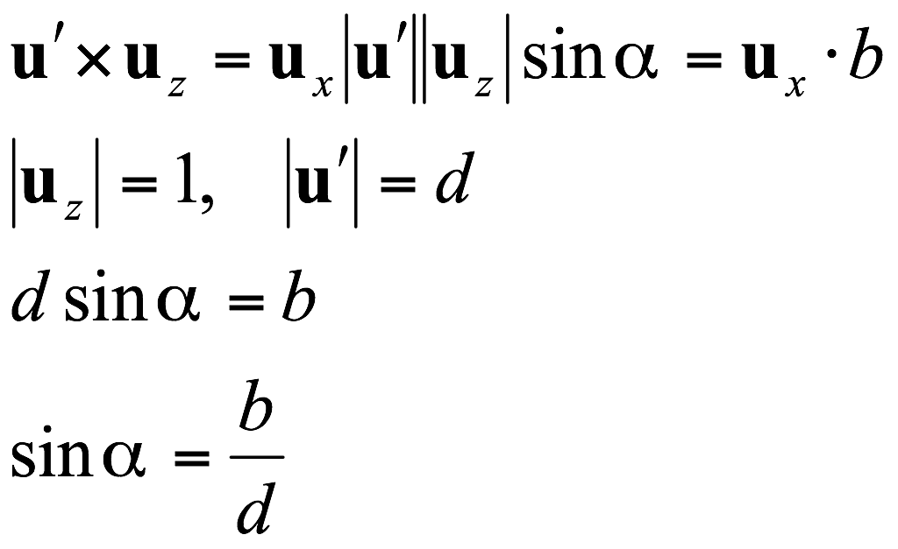
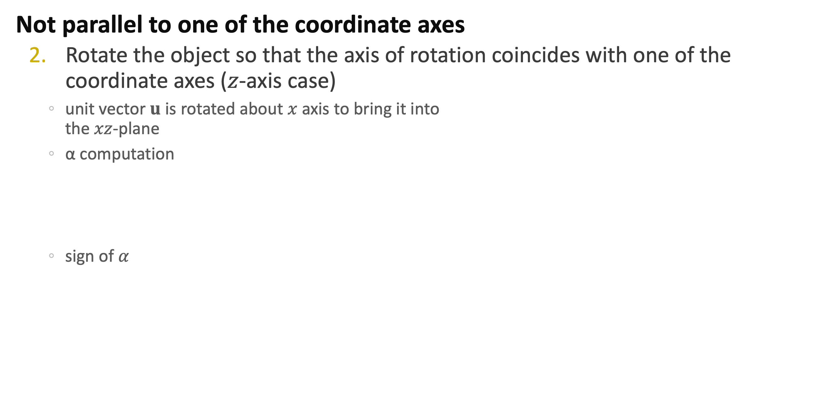
General 3D Rotation
Not parallel to one of the coordinate axes
Rotate the object so that the axis of rotation coincides with one of the coordinate axes ($z$-axis case)
unit vector $u$ is rotated about $x$ axis to bring it into the $xz$-plane
α computation
sign of $α$
u′
α
uz=(0, 0, 1)

Slide 19
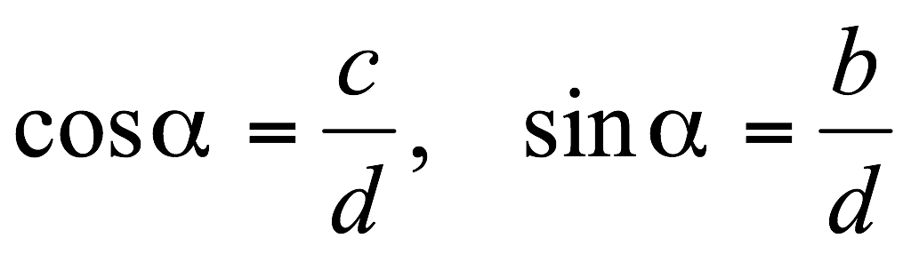
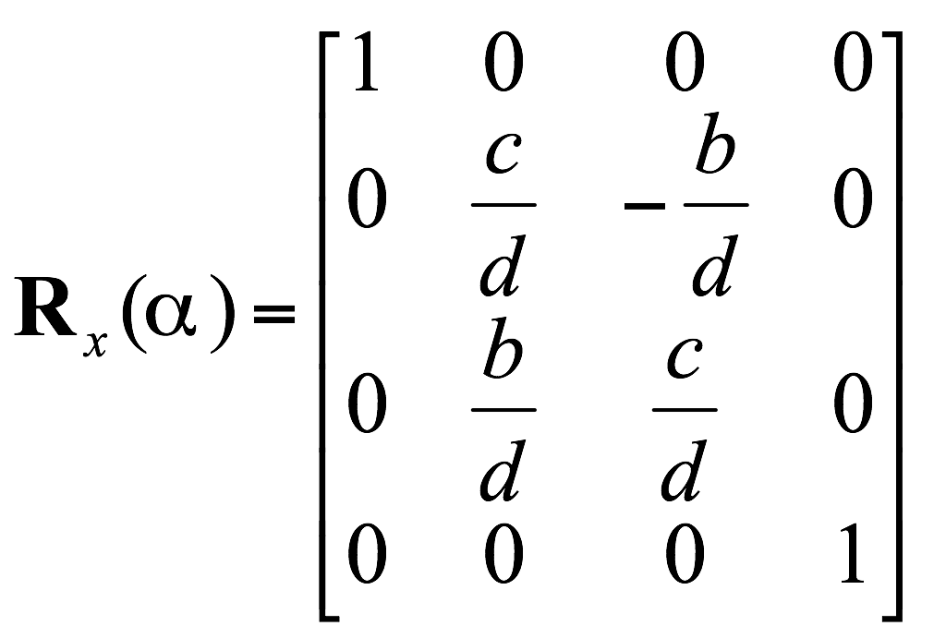
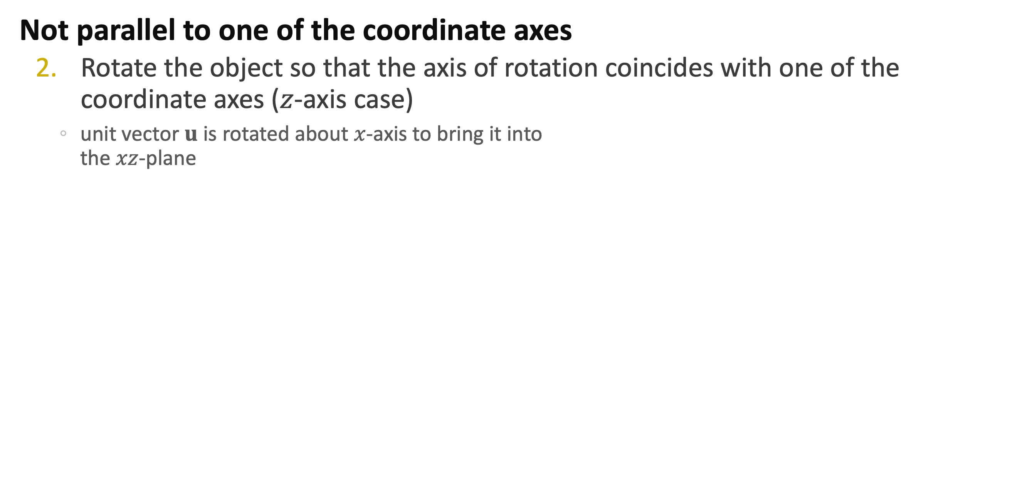
General 3D Rotation
Not parallel to one of the coordinate axes
Rotate the object so that the axis of rotation coincides with one of the coordinate axes ($z$-axis case)
unit vector $u$ is rotated about $x$-axis to bring it into the $xz$-plane
u′
α
uz=(0, 0, 1)

Slide 20
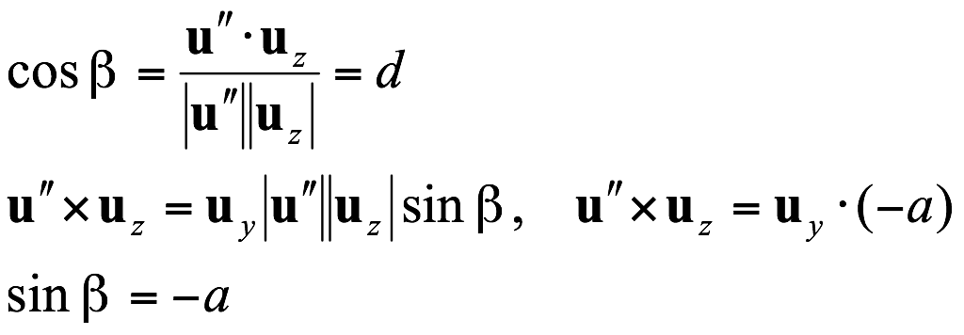
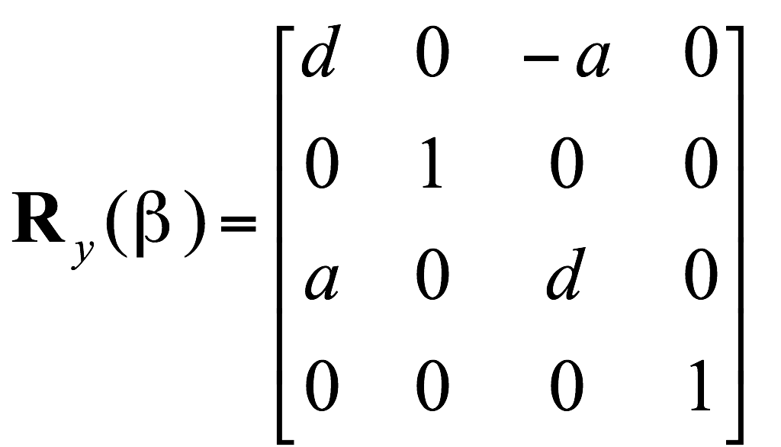
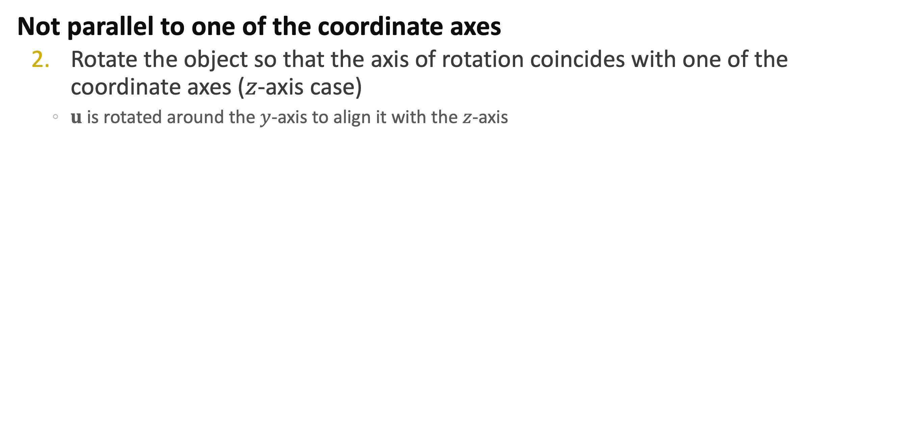
General 3D Rotation
Not parallel to one of the coordinate axes
Rotate the object so that the axis of rotation coincides with one of the coordinate axes ($z$-axis case)
$u$ is rotated around the $y$-axis to align it with the $z$-axis
uz=(0, 0, 1)
u′′=(a, 0, d)

Slide 21
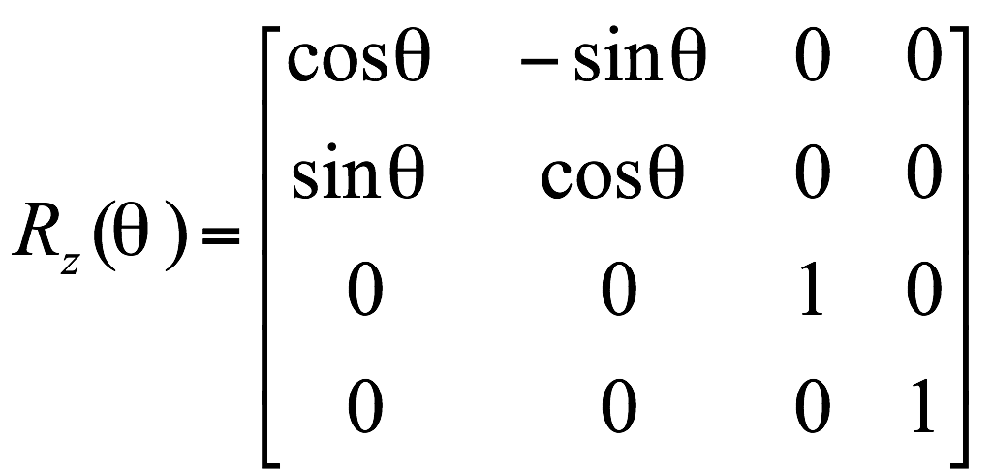
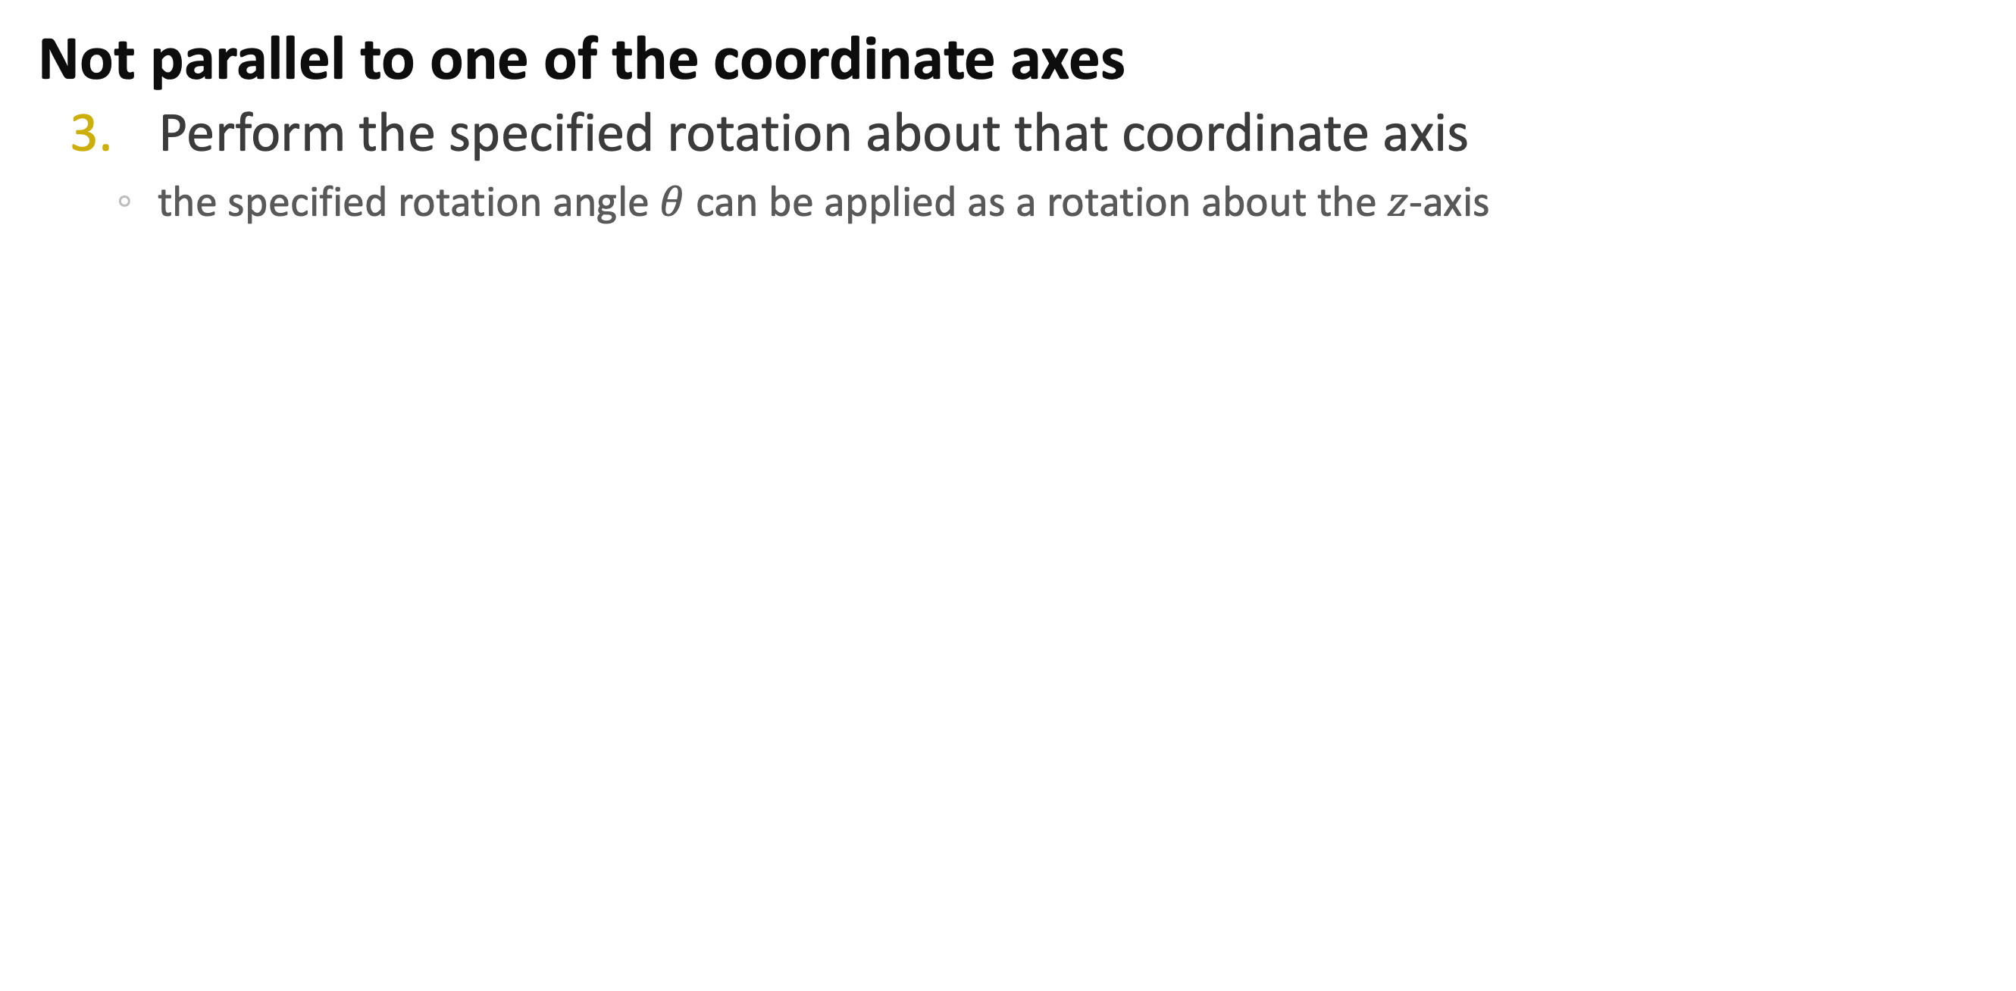
General 3D Rotation
Not parallel to one of the coordinate axes
Perform the specified rotation about that coordinate axis
the specified rotation angle $θ$ can be applied as a rotation about the $z$-axis

Slide 22
General 3D Rotation
Not parallel to one of the coordinate axes
Apply the inverse rotations to bring the rotation axis back to its original orientation
Apply the inverse translation to bring the rotation axis back to its original position

Slide 23
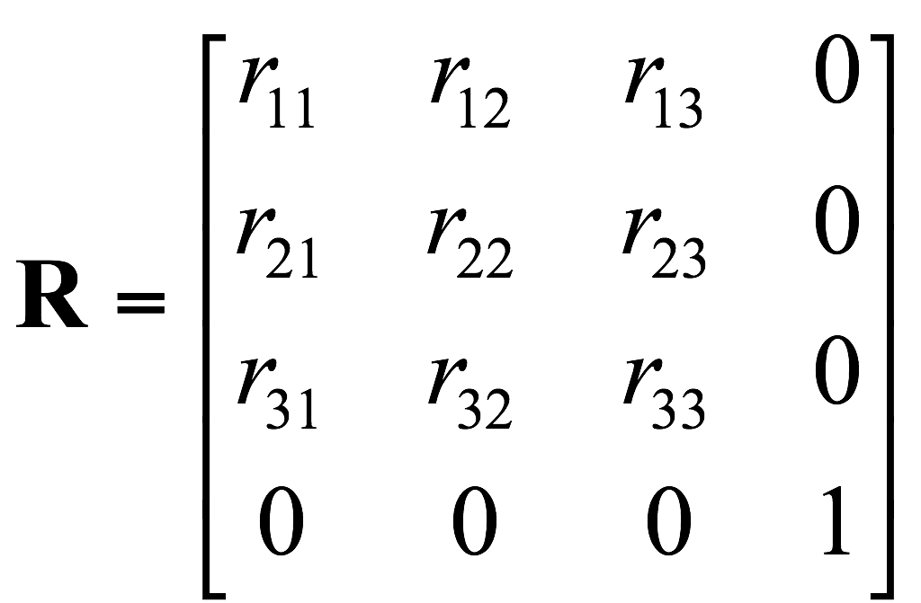
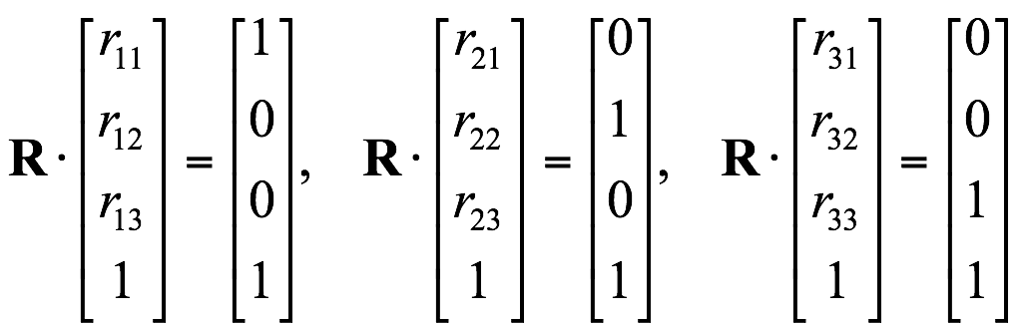
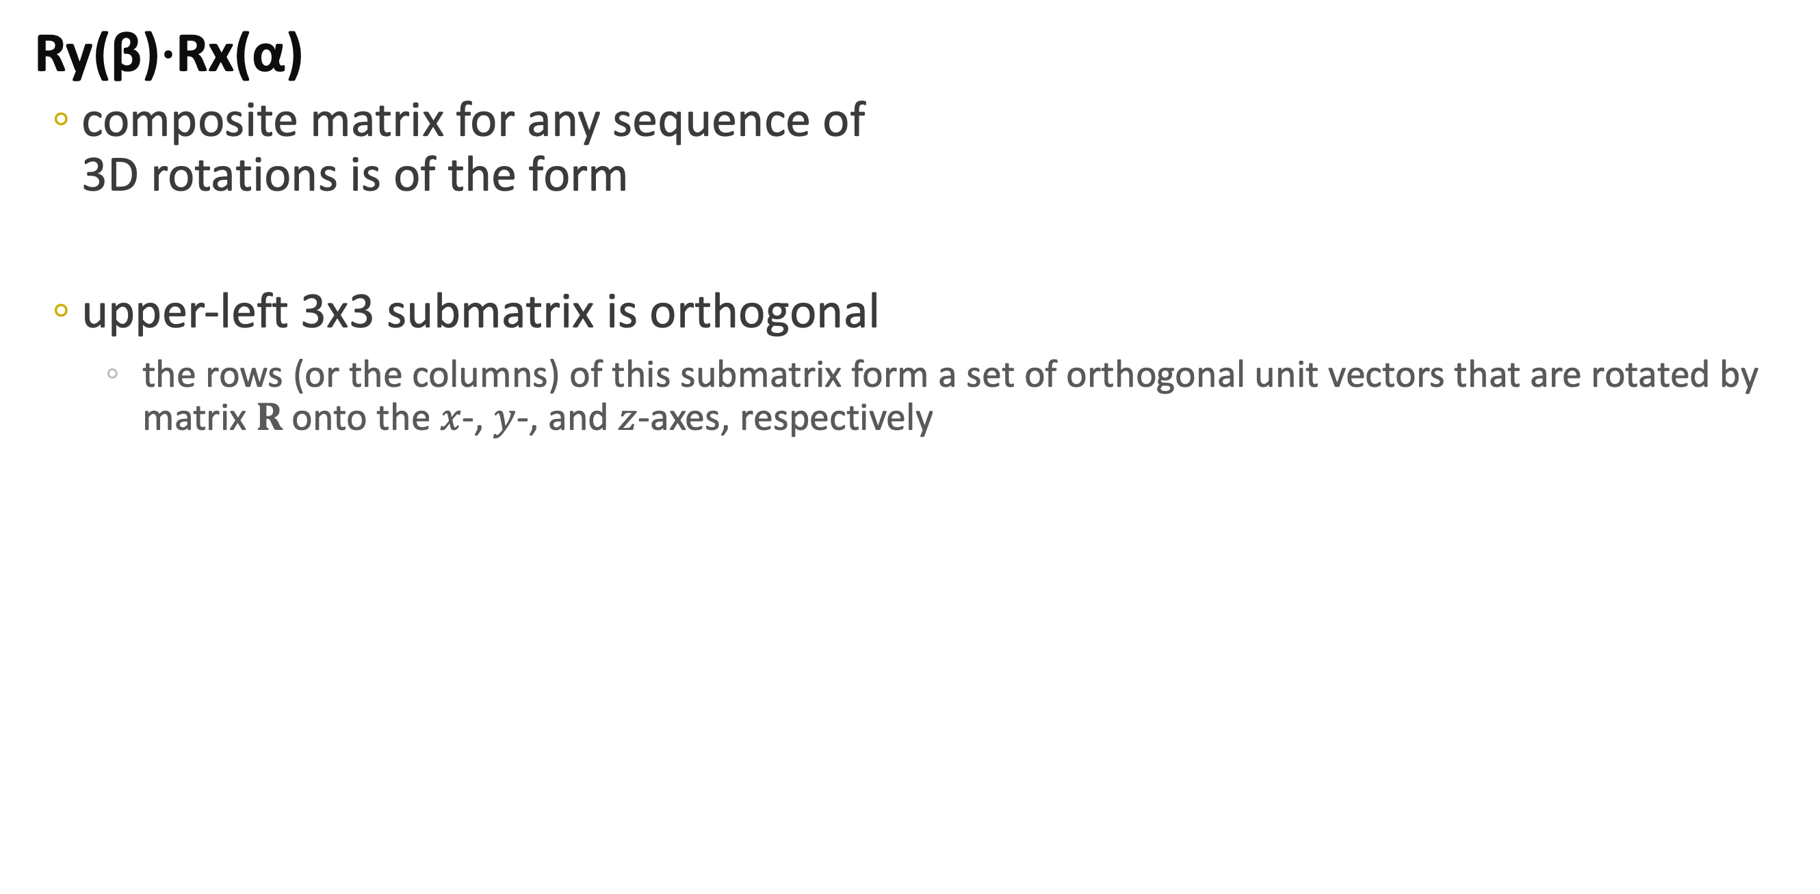
General 3D Rotation
Ry(β)⋅Rx(α)
composite matrix for any sequence of 3D rotations is of the form
upper-left 3x3 submatrix is orthogonal
the rows (or the columns) of this submatrix form a set of orthogonal unit vectors that are rotated by matrix $R$ onto the $x$-, $y$-, and $z$-axes, respectively

Slide 24
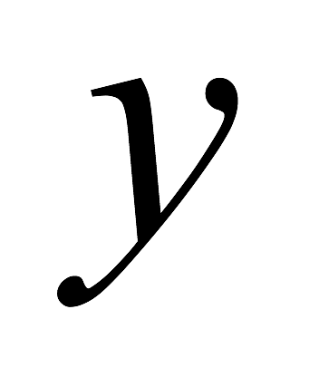
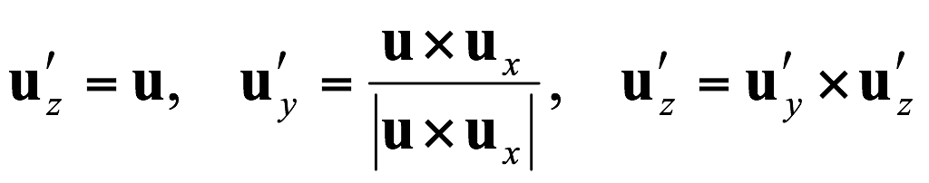
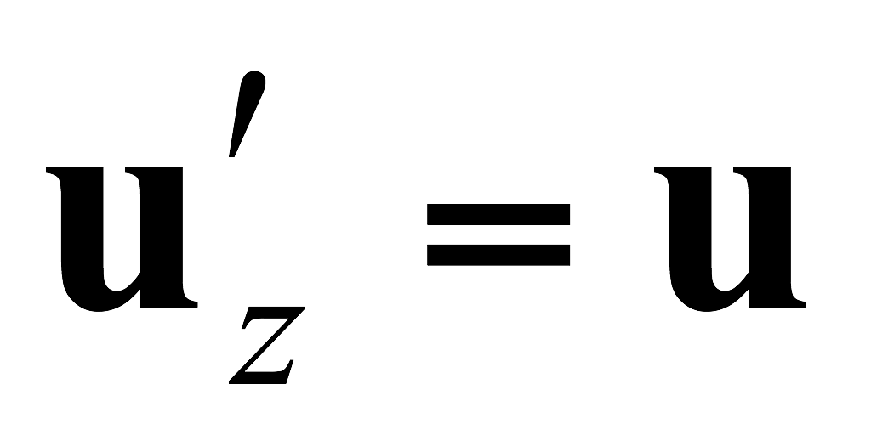






General 3D Rotation
Set up a local coordinate system with one of its axes aligned on the rotation axis
unit vectors for the three coordinate axes are used to construct the columns of the rotation matrix
assuming that the rotation axis is not parallel to any coordinate axis

Slide 25



3D Scaling
Scaling relative to the coordinate origin
simple extension of 2D scaling

Slide 26


3D Scaling
Scaling with respect to any selected fixed position $(x_{f}, y_{f}, z_{f})$
Translate the fixed point to the origin
Apply the scaling transformation relative to the coordinate origin
Translate the fixed point back to its original position

Slide 27

3D Scaling
Scaling with respect to any selected fixed position $(x_{f}, y_{f}, z_{f})$
Translate the fixed point to the origin
Apply the scaling transformation relative to the coordinate origin
Translate the fixed point back to its original position

Slide 28
Composite 3D Transformations
As with 2D transformations, we form a composite 3D transformation by multiplying the matrix representations for the individual operations in the transformation sequence

Slide 29








Other 3D Transformations: Reflection
Reflection relative to an axis
equivalent to 180° rotations about that axis
Reflection with respect to a plane
equivalent to 180° rotations in 4D space
$$y$$
$$y$$
$$z$$
$$x$$
Reflection Relative to the $xy$-plane
$$x$$
$$z$$

Slide 30




Other 3D Transformations: Shear
Shear relative to $x$-, or $y$-axes
similar to 2D shear
$z$-axis shear relative to a reference position

Slide 31








Transformations Between 3D Coordinate Systems
Transformation of object description from $xyz$ coordinates to $x′y′z′$ coordinates
translate so that the origin $(x_{0}, y_{0}, z_{0})$ of the $x′y′z′$ system is moved to the origin $(0, 0, 0)$ of the $xyz$ system
align corresponding coordinate axes
if different scales are used in the two coordinate systems, a scaling transformation may also be necessary

Slide 32


Affine Transformation
Each of the transformed coordinates $x′$, $y′$, and $z′$ a linear function of the original coordinates $x$, $y$, and $z$, and parameters $a_{ij}$ and $b_{k}$ are constants
Parallel lines are transformed into parallel lines and finite points map to finite points
Translation, rotation, scaling, reflection, and shear
Any affine transformation is expressed as some composition of these five transformations
Affine transformation involving only translation, rotation, and reflection preserves angles and lengths, as well as parallel lines

Slide 33
Questions?

Slide 34
In Rendering API
Transformation is handled in ”Vertex Shader”
OpenGL
GLSL Vertex Shader

Slide 35
Shader?
Shader: Small program to process
Vertex
From the input vertices (in modeling coordinate)
Compute screen coordinate
Geometry manipulation
Make primitives from other primitives
Tessellation
Making more primitives
Fragment (pixel) processing
Compute color of fragment (pixel)

Slide 36
Shader?
Shader is
Made as a string
Loaded from file
Compiled by graphic card drivers
Linked with other shaders
At least a vertex shader and a fragment shader is required.
Linked into a “program”

Slide 37
Let’s Learn from Example
#version 410 core
layout(location=0) in vec3 in_Position;
layout(location=1) in vec2 in_TexCoord;
uniform mat4 viewMat;
uniform mat4 projMat;
uniform mat4 modelMat;
uniform mat3 textMat;
out vec2 textCoord;
void main(void) {
vec4 worldPos = modelMat*vec4(in_Position, 1.0);
gl_Position= projMat*viewMat*worldPos;
textCoord = (textMat*vec3(in_TexCoord,1)).xy;
}

Slide 38
Compilation Setting
#version 410 core
The version of GLSL language
410 for OpenGL 4.1
Usually >=320
Other compilation setting + Preprocessor
#extension
#define
#ifdef …
no #include

Slide 39
Input
layout(location=0) in vec3 in_Position;
layout(location=1) in vec2 in_TexCoord;
Input from vertex array buffer
“location” must be the same as # in glVertexAttribPointer
vec3, vec2: variable types
in_Position: variable name of the vertex attribute #0
in_TexCoord: variable name of the vertex attribute #1

Slide 40
What Kinds of Types are Available?
Numbers
bool
int
float
Vector
vec2, vec3, vec4
bvec2, bvec3, bvec4
ivec2, ivec3, ivec4
Matrix
mat2, mat3, mat4

Slide 41
Uniform Variables
uniform mat4 viewMat;
uniform mat4 projMat;
uniform mat4 modelMat;
uniform mat3 textMat;
Uniforms values are the values that
Set by the your C++ program
Used for glDrawElements or similar
Cannot be modified during a single glDrawElements call
If you want to change it per part, either
Use vertex attribute or
Divide elements into more than one call.

Slide 42
Output Variables
out vec2 textCoord;
The values that will be used in the next stage
There are some default variables
gl_Position
Position in normalized coordinate
We will learn how to compute it later.

Slide 43
Shader Body
void main(void) {
Starting point of the program
vec4 worldPos = modelMat*vec4(in_Position, 1.0);
Do some computation
Here, a matrix and vector can be multiplied.
gl_Position= projMat*viewMat*worldPos;
You must set gl_Position.
textCoord = (textMat*vec3(in_TexCoord,1)).xy;
You compute other output variables.
}

Slide 44
Now, You Can Read the Code
#version 410 core
layout(location=0) in vec3 in_Position;
layout(location=1) in vec2 in_TexCoord;
uniform mat4 viewMat;
uniform mat4 projMat;
uniform mat4 modelMat;
uniform mat3 textMat;
out vec2 textCoord;
void main(void) {
vec4 worldPos = modelMat*vec4(in_Position, 1.0);
gl_Position= projMat*viewMat*worldPos;
textCoord = (textMat*vec3(in_TexCoord,1)).xy;
}

Slide 45
Glance At Fragment Shader
#version 410 core
out vec4 out_Color;
void main(void) {
out_Color = vec4(1.0, 0.0, 0.0, 1.0);
}

Slide 46
The Shader We are Using
#version 410 core
layout(location=0) in vec3 in_Position;
uniform mat4 viewMat = mat4(1,0,0,0,0,1,0,0,0,0,1,0,0,0,-3,1);
uniform mat4 projMat = mat4(1.299038, 0, 0, 0, 0, 1.732051, 0, 0, 0, 0, -1.002002, -1.0, 0, 0, -0.2002, 0);
// Here, we need uniform for transformation
void main(void) {
// Here we need to compute worldPos
// By multiplying model matrix and in_Position
gl_Position= projMat*viewMat* worldPos;
}

Slide 47
In the C program
Shader Preparation
GLuint vShader = glCreateShader( GL_VERTEX_SHADER );
Creating a new vertex shader
glShaderSource( vShader, #strings, string, #characters );
Setting source
glCompileShader( vShader );
This will compile the shader
Can fail!!
You need to do the same thing for Fragment shader

Slide 48
In C Program
Linking a program
GLuint prog = glCreateProgram();
Creating a new program
glAttachShader( prog, vShader );
glAttachShader( prog, fShader );
Attaching the compiled shaders
glLinkProgram( prog );
Link!
Whenever you want to use the program,
glUseProgram( prog );
Look at toys.h
Note: you can have many programs at a time
but use one at a time.

Slide 49
Setting Uniform Variables
Each uniform has “Unique” location (index)
You can set value of a uniform variable using this location.
GLuint loc = glGetUninform( prog, “someUniformVar” );
Getting the location of “someUniformVar” from prog
glUniform1i( loc, value );
Setting value at loc.

Slide 50
Uniform Setting Functions
Simple Values
glUniform1i, glUniform1d, glUniform1f
Vectors
glUniform3f(loc, x, y, z ); …
Array
glUniform1fv( loc, count, array );
glUniform3fv( loc, count, vectorArray );
Matrix
glUniformMatrix4fv( loc, count, transpose?, pointer );
glUniformMatrix3fv( loc, count, transpose?, pointer );

Slide 51
With GLM
Pointer converter
#include <glm/gtc/type_ptr.hpp>
..
glUniformMatrix4fv(loc, 1, 0, glm::value_ptr(rotMat));

Slide 52
With GLM
Transformation matrices
#include <glm/gtx/transform.hpp>
Rotation matrix
glm::rotate( angle, axis );
glm::translate( vector );
glm::scale( vector );

Slide 53
Complete Example
For convenience
using namespace glm;
In render function
GLuint loc = glGetUniformLocation( program.programID, "modelMat" );
mat4 rotMat = rotate(rotAngle, vec3(0,1,0) );
glUniformMatrix4fv(loc, 1, 0, value_ptr(rotMat));

Slide 54
Assignment #2
Make a Rotating Bunny
Use j3a.hpp / j3a.cpp
std::vector<glm::vec3*> vertices;
std::vector<unsigned> nVertices;
std::vector<glm::u32vec3*> triangles;
std::vector<unsigned> nTriangles;

Slide 55
Assignment #2
In initialization function,
loadJ3A( “…./bunny.j3a”);
program.loadShaders("shader.vert", "shader.frag");
glGenVertexArrays(1, &vertexArrayID);
glBindVertexArray(vertexArrayID);
glGenBuffers(1, &triangleVBO);
glBindBuffer(GL_ARRAY_BUFFER, triangleVBO);
glBufferData(GL_ARRAY_BUFFER, nVertices[0]*sizeof(glm::vec3), vertices[0], GL_STATIC_DRAW);
glBindBuffer(GL_ARRAY_BUFFER, triangleVBO);
glEnableVertexAttribArray(0);
glVertexAttribPointer(0, 3, GL_FLOAT, GL_FALSE, 0, 0);
glGenBuffers(1, &indexVBOID);
glBindBuffer(GL_ELEMENT_ARRAY_BUFFER, indexVBOID);
glBufferData(GL_ELEMENT_ARRAY_BUFFER, nTriangles[0]*sizeof(glm::u32vec3), triangles[0], GL_STATIC_DRAW);

Slide 56
Assignment #2
In rendering function,
glBindBuffer(GL_ELEMENT_ARRAY_BUFFER, indexVBOID);
glDrawElements(GL_TRIANGLES, nTriangles[0]*3, GL_UNSIGNED_INT, 0);

Slide 57
Assignment #2
Modify shader.vert
Declare modelMat matrix (4x4) as uniform
Transform in_Position with modelMat to make worldPos (vec4)
Make gl_Position as in the example
Make it rotated
At every frame, increase rotation angle
Make a 4x4 matrix to rotate a thing about Y-axis
Set uniform value in the shader

